Slide 1



NREGA ANALYSIS
With Tableu
A presentation by Ankit Kumar

Slide 2
Problem Statement
This project aims to evaluate the effectiveness of the Mahatma Gandhi National Rural Employment Guarantee Act (NREGA) in alleviating rural unemployment and poverty. Key areas of investigation include assessing the scheme's effectiveness in providing employment opportunities to rural households, identifying regional disparities in its implementation and outcomes, examining the utilization of allocated budgets and their correlation with employment generation, determining the factors contributing to the completion of NREGA works, and identifying any roadblocks to its success. Additionally, the project seeks to explore how data-driven insights can guide policymakers and administrators in optimizing the scheme's impact.

Slide 3
Dataset Description
1. Variable Description:
The dataset consists of the following variables:
● state_name: Name of the Indian state.
● district_name: Name of the district within the state.
● Total No. of JobCards issued: The total number of job cards issued to rural households.
● Total No. of Workers: The total number of workers registered under NREGA.
● Total No. of Active Job Cards: The number of active job cards at a given point in time.
● Total No. of Active Workers: The number of workers currently engaged in NREGA works.
● SC workers against active workers: The count of Scheduled Caste workers among active workers.
● ST workers against active workers: The count of Scheduled Tribe workers among active workers.
● Approved Labour Budget: The budget allocated for labor under NREGA.

Slide 4
Persondays of Central Liability so far: The total persondays
of employment provided, considering central liability.
● SC persondays: Persondays of employment provided to Scheduled Caste workers.
● ST persondays: Persondays of employment provided to Scheduled Tribe workers.
● Women Persondays: Persondays of employment provided to women.
● Average days of employment provided per Household: The average number of days
of employment provided per rural household.
● Average Wage rate per day per person(Rs.): The average daily wage rate per NREGA worker
in Indian Rupees.
● Total No of HHs completed 100 Days of Wage Employment: The number of
households completing 100 days of wage employment.
● Total Households Worked: The total number of households involved in NREGA works.
● Total Individuals Worked: The total number of individuals engaged in NREGA works.
● Differently abled persons worked: The count of differently abled persons who participated
in NREGA works.
● Number of GPs with NIL exp: The number of Gram Panchayats with zero expenditure.
● Total No. of Works Takenup (New+Spill Over): The total number of works initiated, including
new projects and spill-over from previous periods.
● Number of Ongoing Works: The count of works that are currently in progress.
● Number of Completed Works: The count of works that have been successfully completed.
● % of NRM Expenditure(Public + Individual): The percentage of expenditure on Natural
Resource Management (NRM) projects, including both public and individual contributions.
● % of Category B Works: The percentage of expenditure on Category B works.
● % of Expenditure on Agriculture & Agriculture Allied Works: The percentage of expenditure
on agriculture and allied activities.
● Total Exp(Rs. in Lakhs.): Total expenditure in Indian Rupees (in lakhs).
● Wages(Rs. In Lakhs): Expenditure on wages in Indian Rupees (in lakhs).
● Material and skilled Wages(Rs. In Lakhs): Expenditure on materials and skilled wages in
Indian Rupees (in lakhs).
● Total Adm Expenditure (Rs. in Lakhs): Total administrative expenditure in Indian Rupees
(in lakhs).

Slide 5
Project Objectives
1. Data Cleaning and Preparation: - Clean and preprocess the dataset, handling missing values or outliers. - Convert relevant columns to appropriate data types.
2. Exploratory Data Analysis (EDA): - Explore patterns and distributions in view counts, like counts, and comments. - Identify trends in the popularity and engagement of YouTube song videos.
3.Utilizing data visualization techniques to present key findings effectively.
4.Drawing actionable insights to inform policymakers and administrators about the strengths and weaknesses of the NREGA program.

Slide 6
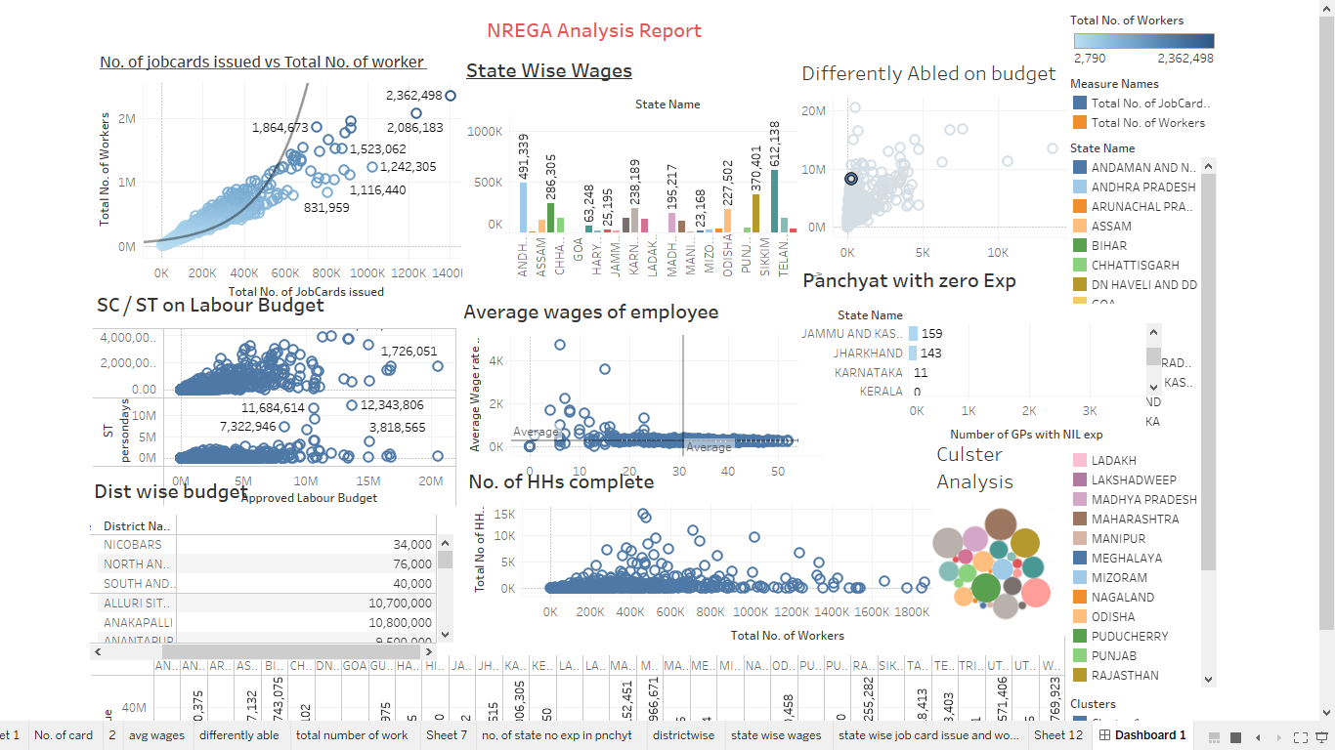
How effective is NREGA in providing employment opportunities to rural households? - It is clearly shown that how NREGA is effective in rural households With the help of graph is clearly shown that Number of card issued is less than number of Workers. It’s show that people are more actively enggage in employment opportunity

Slide 7
Are there regional disparities in the implementation and outcomes of the scheme? -In graphs it shown government make budget allocation on weaker section make more work opportunity in graph it shown that distripution of budget on sc/st workers

Slide 8
What is the utilization of the allocated budget, and how does it correlate with employment generation? -Allocation of Budget Play a cricual role in employment generation here a graphs show distribution of budget in different state of india and average wages of employee.
.

Slide 10
THANKS

